Slide 1




NEXT GEN EMPLOYABILITY PROGRAM
Creating a future-ready workforce
Team Members
College Name
Student Name : SUBA SHREE K B
Student ID : au311121104057
Loyola-ICAM College of Engineering and Technology

Slide 2

CAPSTONE PROJECT SHOWCASE
Project Title
MUSIC WEB APPLICATION USING DJANGO FRAMEWORK
Abstract | Problem Statement | Project Overview | Proposed Solution | Technology Used | Modelling & Results | Conclusion

Slide 3
Abstract
MusicBeats is a music web app having Django framework as its backend.
MusicBeats is a user-friendly web application designed to provide users with easy access to a vast collection of songs, including golden hits, along with convenient features such as listening to songs and downloading MP3 files of songs without logging in to it
Authenticated users can upload songs to channels, and add songs to a "listen later" playlist.
With MusicBeats, users can enjoy their favorite music hassle-free, making it a standout choice in the realm of online music platforms.
MusicBeats stands out in the online music platform landscape by offering a combination of a vast music library, free downloads, and a user-centric approach. This empowers users to enjoy their music on their terms, fostering a hassle-free and personalized listening experience.
Source :

Slide 4
Problem Statement
Current music platforms lack inclusivity and accessibility, hindering users from exploring new music easily. Existing streaming services rely heavily on user history for recommendations, limiting users' exposure to diverse genres and emerging trends. Additionally, the necessity of login for basic features like listening and downloading songs creates barriers to smooth music enjoyment. There is a clear need for a music web application that:
Provides Accessible Features: Users should access songs and download MP3 files without mandatory login.
Encourages Music Exploration: The platform should offer a diverse range of songs, including golden hits, and facilitate music discovery through features like playlist creation and channel uploads.
Enhances User Experience: Offering a user-friendly interface and smooth navigation, the app should prioritize ease of use to ensure a hassle-free music experience.
The proposed app must aim to address these issues, provide users with an inclusive and enjoyable music discovery and listening platform.
Source :

Slide 5
Project Overview
MusicBeats is a music web application designed to provide users with easy access to a vast collection of songs.
The homepage features a navigation bar with links to browse all songs, a search bar for easy discovery, and options for login and sign up.
Below the navigation bar, users can enjoy a slideshow showcasing attractive images, followed by a curated list of golden hits and a "listen later" section.
The app allows users to listen to songs without the need to login, providing a seamless music listening experience.
Additionally, users have the unique ability to download MP3 files of songs without subscribing, distinguishing MusicBeats from other music apps.
After signing up, users gain access to additional features such as uploading songs to channels and creating a personalized "listen later" playlist.
The app is built using the Django framework for the backend and HTML, CSS, JavaScript, and Bootstrap for the frontend, ensuring a modern and responsive user interface.
Source :

Slide 6
Proposed Solution
MusicBeats aims to revolutionize the way users discover, access, and enjoy music by offering a comprehensive and user-friendly web application.
User-Friendly Interface:
- MusicBeats has a simple and visually appealing interface.
- Key features like browsing songs, searching, and logging in are easily accessible from the navigation bar.
- A slideshow and list of golden hits attract users to explore further.
Convenient Access to Songs:
- No login required to listen to songs, promoting spontaneous music discovery.
- Unique feature allowing users to download MP3 files of songs without subscribing.
- Easy transition between browsing, listening, and downloading music.
Personalized Features:
- Upon signup, users can create playlists, add songs to "listen later" and share their music.
Source :

Slide 7
Robust Backend Architecture:
- Built on the Django framework, providing scalability and security.
- Ensures secure user authentication, efficient data management, and seamless integration with frontend.
Modern Frontend Design:
- Utilizes HTML, CSS, JavaScript, and Bootstrap for a responsive and visually appealing design.
- Dynamic UI elements and smooth transitions enhance usability.
Integration with Social Media and External Platforms:
- Direct links to YouTube videos provide additional context and content related to songs.
With its user-friendly interface, convenient access to music, personalized features, robust backend architecture, modern frontend design, and seamless integration with social media and external platforms, MusicBeats sets a new standard for online music platforms, empowering users to explore and enjoy music in ways never before possible.
Source :

Slide 8


Technology Used
Front-end
Back-end
Source :

Slide 9
Modelling & Results
The architecture of MusicBeats involves a well-structured backend built on the Django framework, facilitating efficient data management and user authentication.
The frontend is designed using HTML, CSS, JavaScript, and Bootstrap, ensuring a visually appealing and responsive interface across devices.
In terms of modeling, MusicBeats implements a robust database design using Django's Object-Relational Mapping (ORM) to efficiently manage user data, song information, playlists, and user interactions.
The database schema is structured to accommodate various user activities, including listening to songs, downloading MP3 files, creating playlists, and adding songs to the "listen later" queue. This ensures that user data is organized and accessible, facilitating seamless navigation and interaction within the platform.
MusicBeats tracks key engagement metrics such as active users, session duration, and song plays to evaluate user interaction and platform usage patterns. This data allows MusicBeats to optimize features and content to better align with user preferences and interests..
Source :

Slide 10
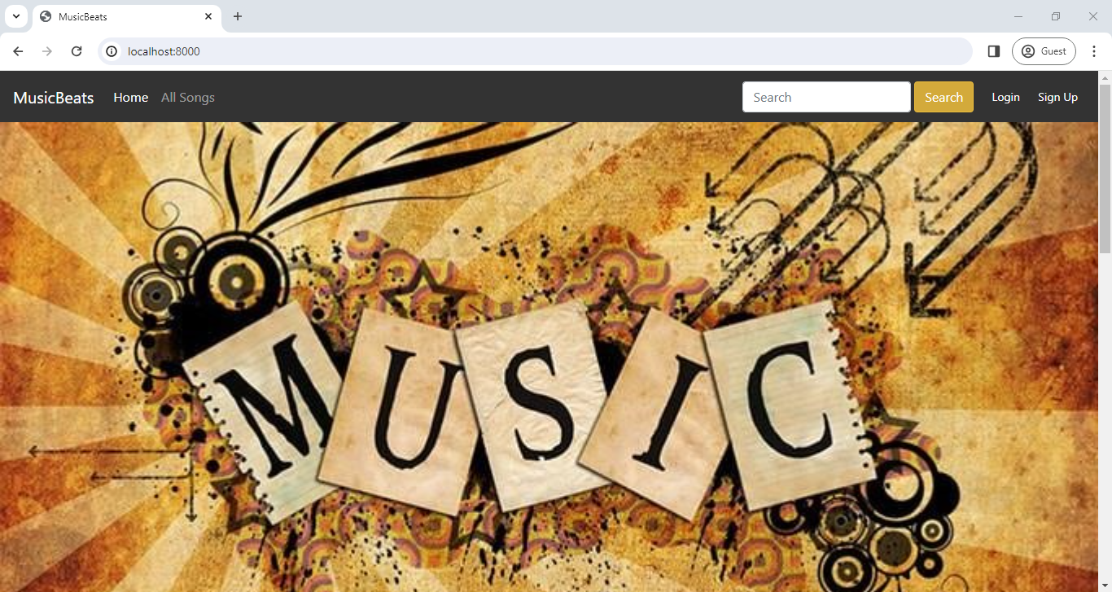
Home Page

Slide 11
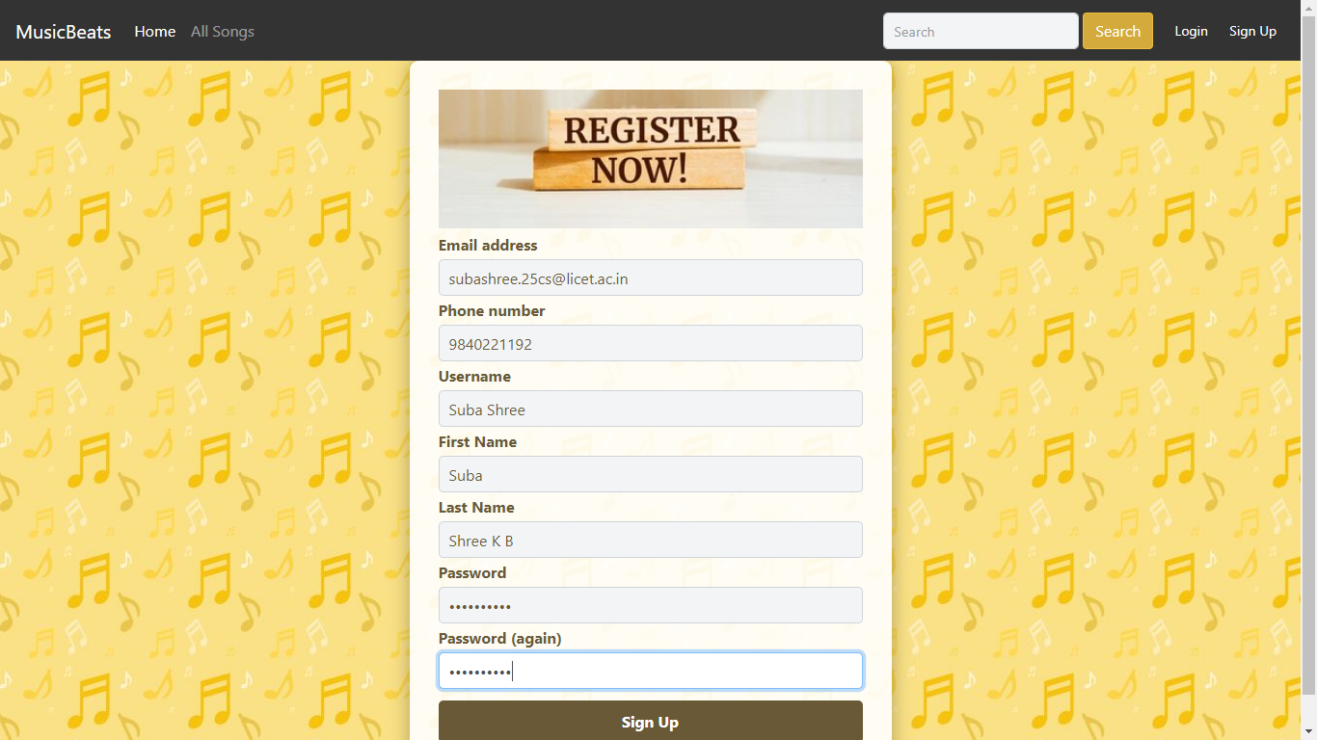
Sign Up Page

Slide 12
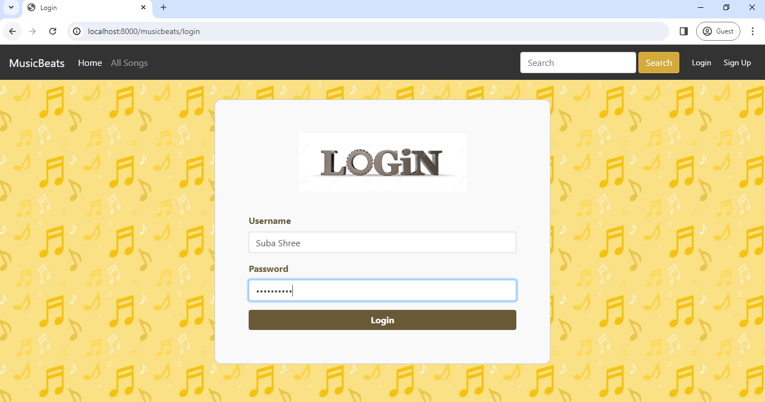
Login Page

Slide 13
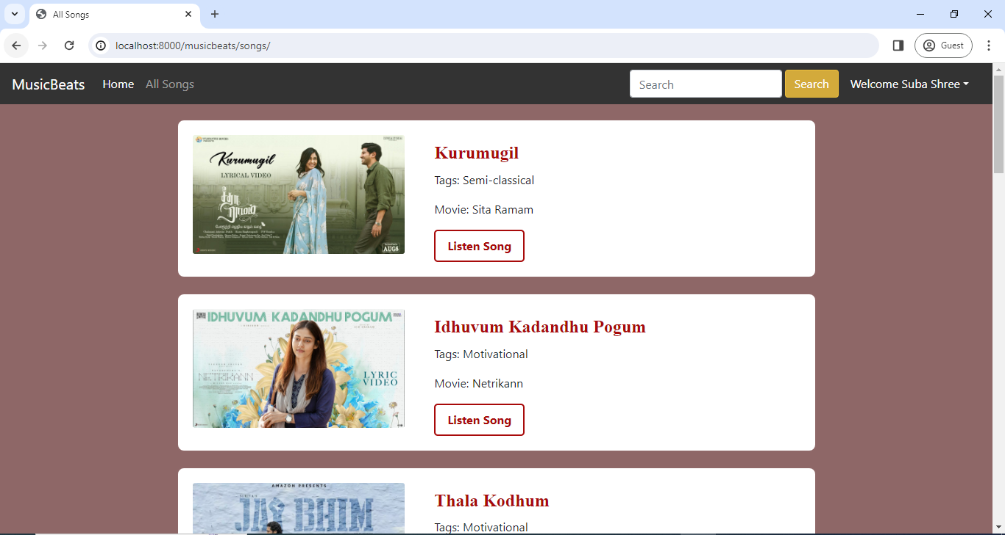
All Songs Page

Slide 14
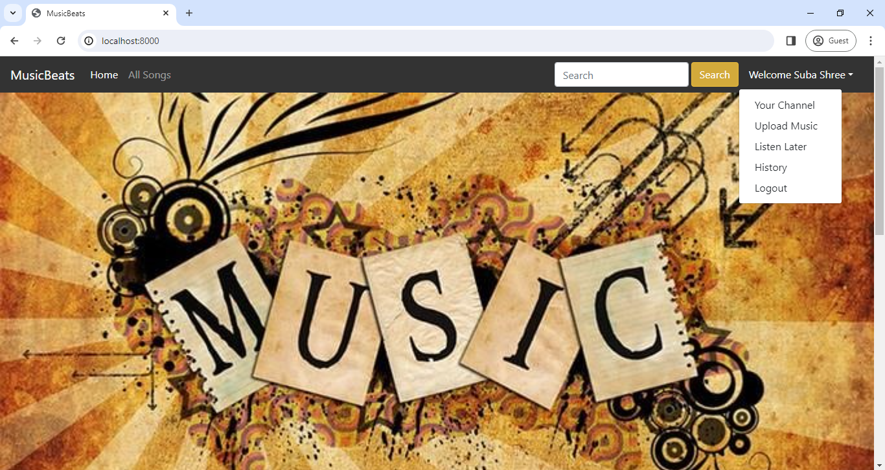
Services List in Menu

Slide 15
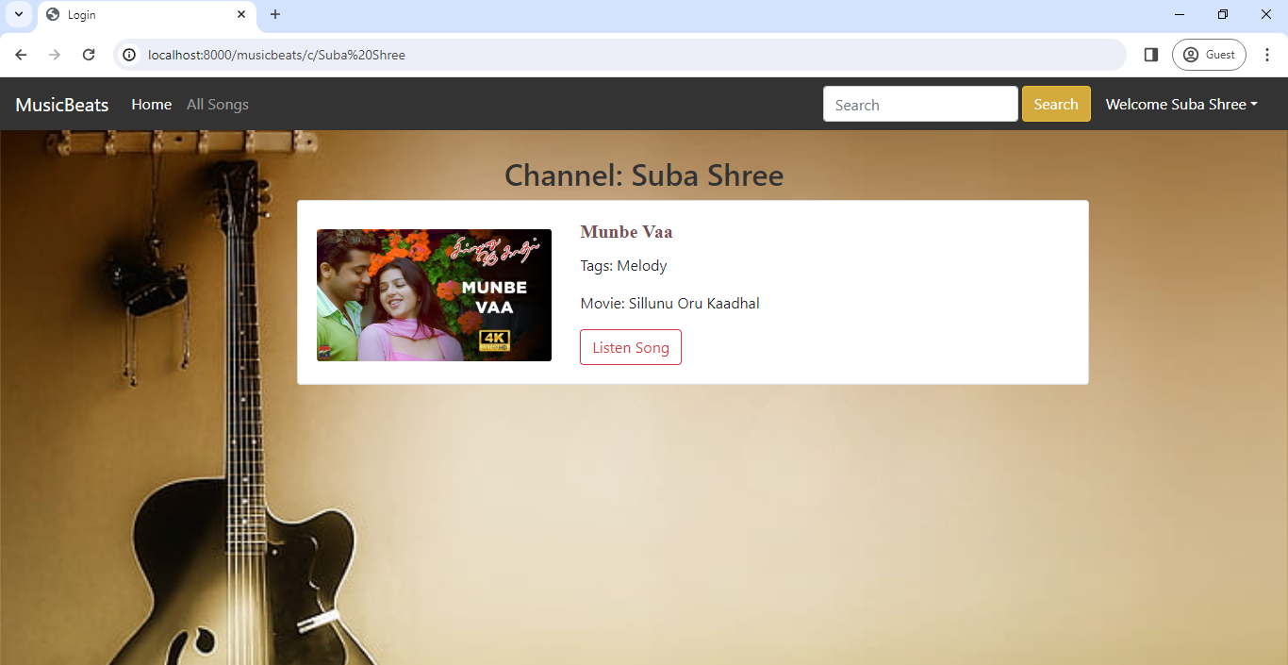
Your Channel Page

Slide 16
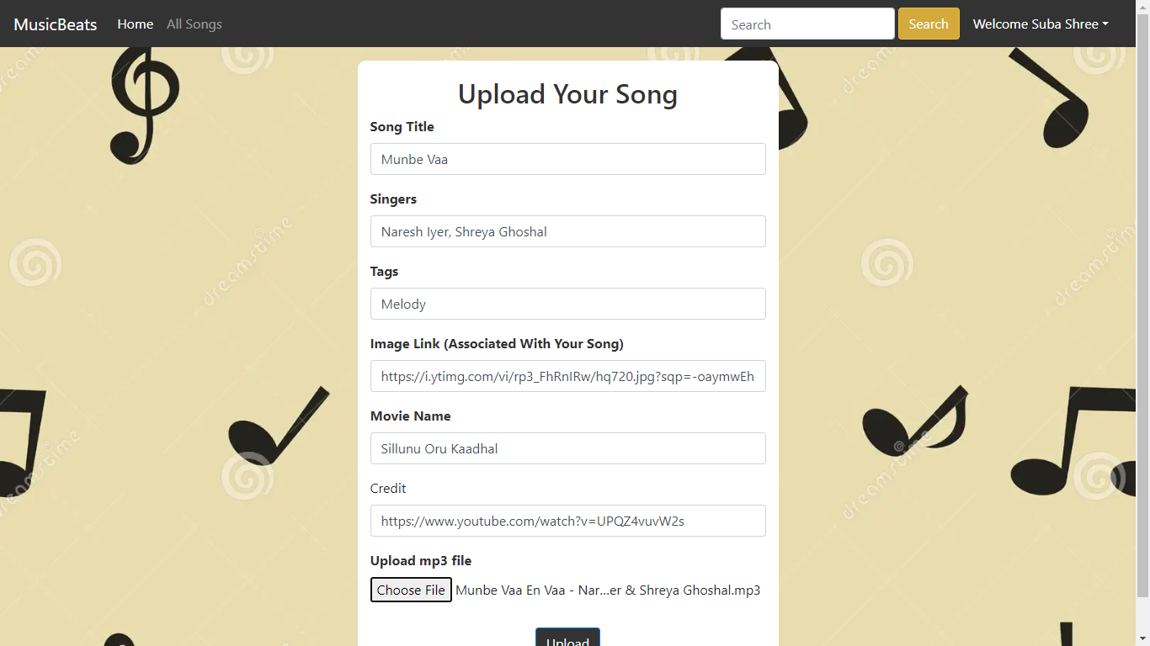
Upload Music Page

Slide 17
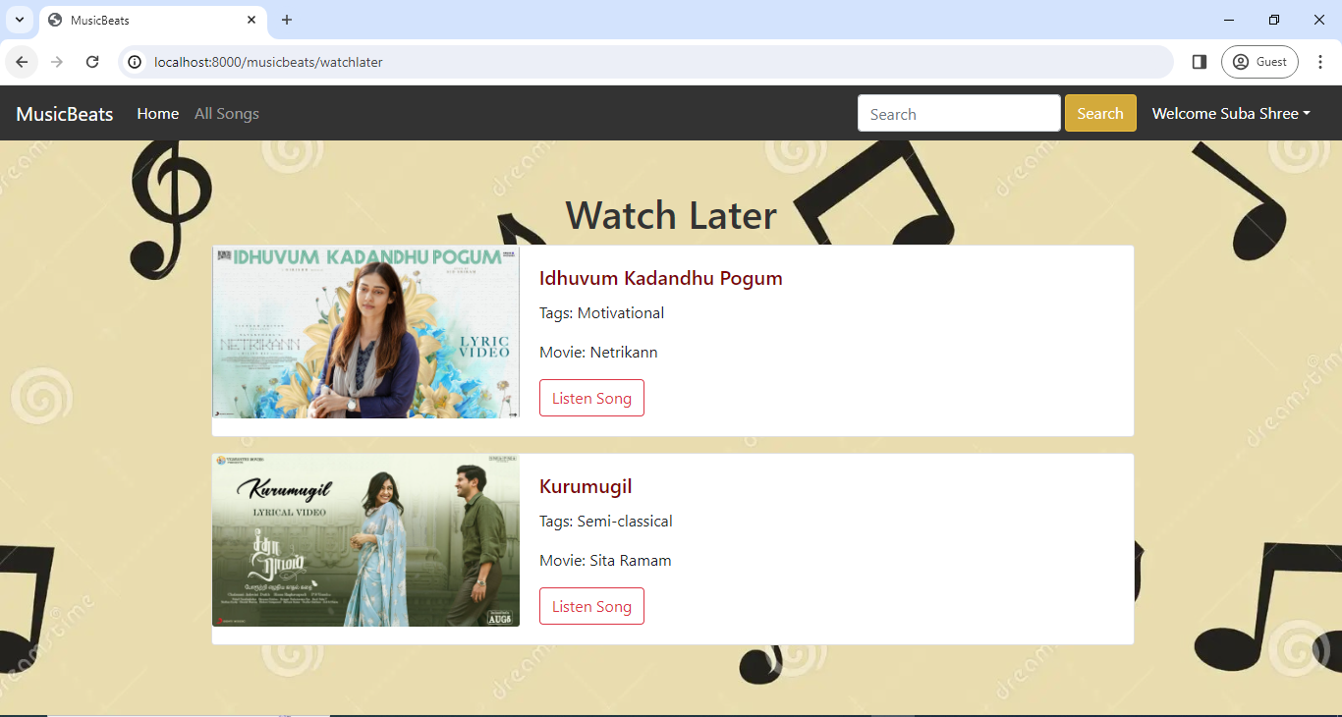
Watch-Later Page

Slide 18
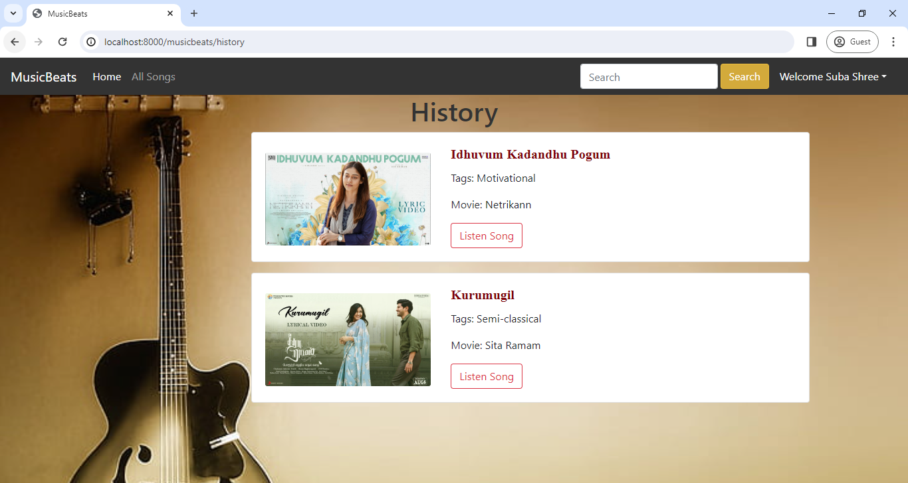
History Page

Slide 19
Future Enhancements:
Category-wise Songs: MusicBeats will introduce advanced categorization features, allowing users to browse songs based on specific genres, eras (such as 80s, 90s, 2ks), moods, and more.
Subscription Model: Introduce a premium subscription tier offering advanced features , high-fidelity audio and exclusive content
Social Integration: Integrate social media features like:
Sharing playlists with friends on social media platforms.
Following other users and discovering music based on their listening habits.
Potentially creating collaborative playlists with friends.
Mobile App: Develop a mobile application to extend MusicBeats reach beyond web browsers and allow for offline listening with downloaded music.
AI-powered Recommendations: Implement an AI recommendation system that personalizes music suggestions based on user listening history, genres they prefer, and trending music.

Slide 20
Conclusion
MusicBeats represents a significant advancement in the realm of online music platforms, offering users a seamless and enjoyable music discovery and listening experience.
With its user-friendly interface, unique features, and robust backend architecture, MusicBeats stands out as a standout choice for music enthusiasts seeking to explore and enjoy new music effortlessly.
Through ongoing development and enhancements, MusicBeats will continue to evolve and adapt to meet the changing needs and preferences of its users, solidifying its position as a leading music web application in the digital landscape.
Source :

Slide 21
Thank You!
Notes:
Thank You !!

